Slide 1
Rank Persistence: Assessing the Temporal Performance of Real-World Person Re-Identification
Srikrishna Karanam, Eric Lam, and Rich Radke
This material is based upon work supported by the U.S. Department of Homeland Security under Award Number 2013- ST-061-ED0001. The views and conclusions contained in this document are those of the authors and should not be interpreted as necessarily representing the official policies, either expressed or implied, of the U.S. Department of Homeland Security.

Slide 2
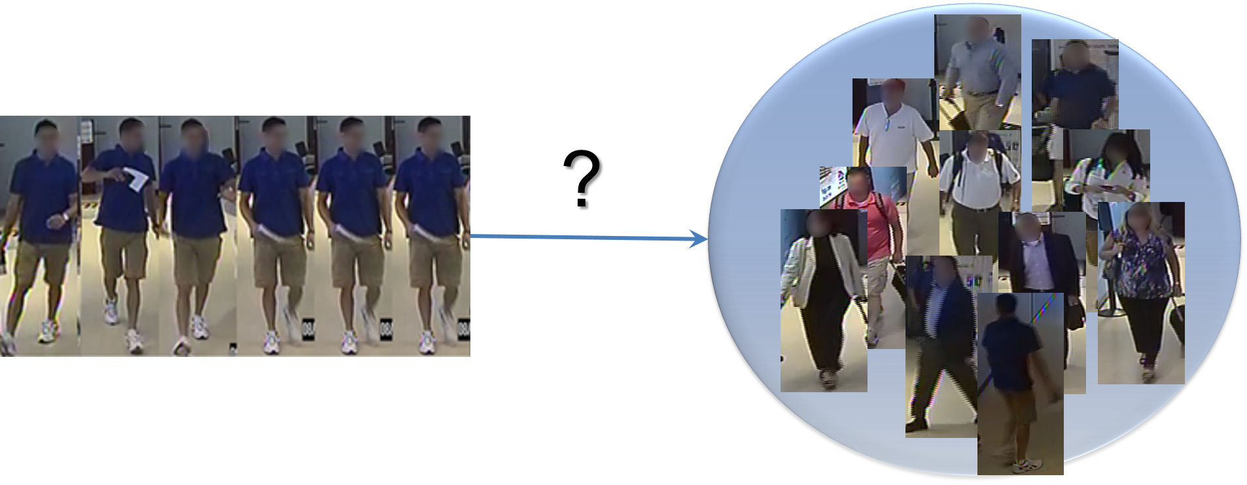
Person Re-Id: The Problem
Gallery
Probe
In computer vision, this is called the re-identification problem.

Slide 3





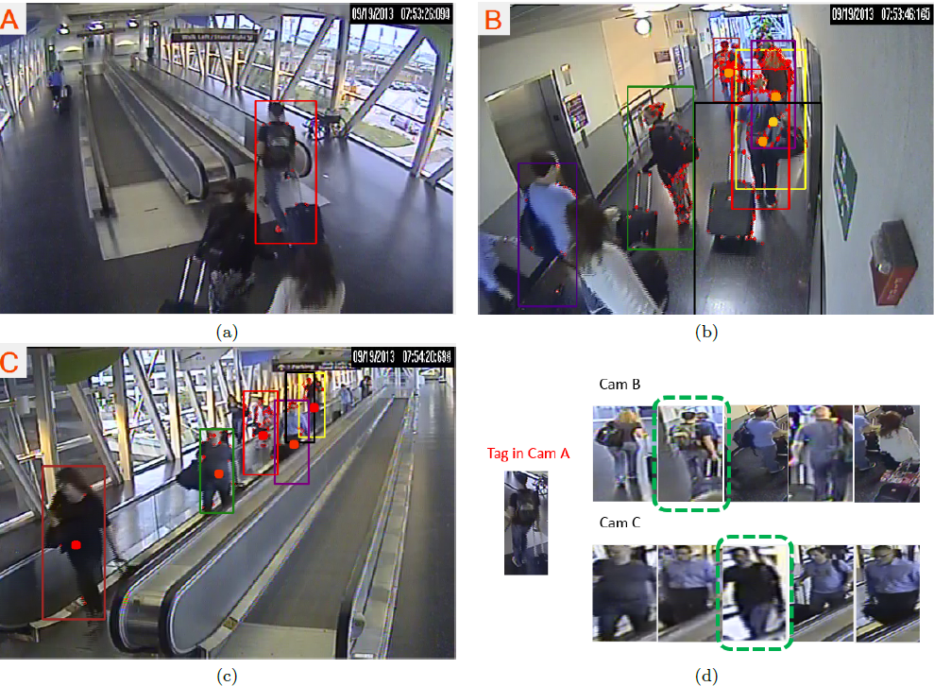











Person Re-Id: Vision Conferences vs. The Real World
Vision conferences
Real World
Query
Batch of candidates, presented at once
Temporally incremental gallery

Slide 4
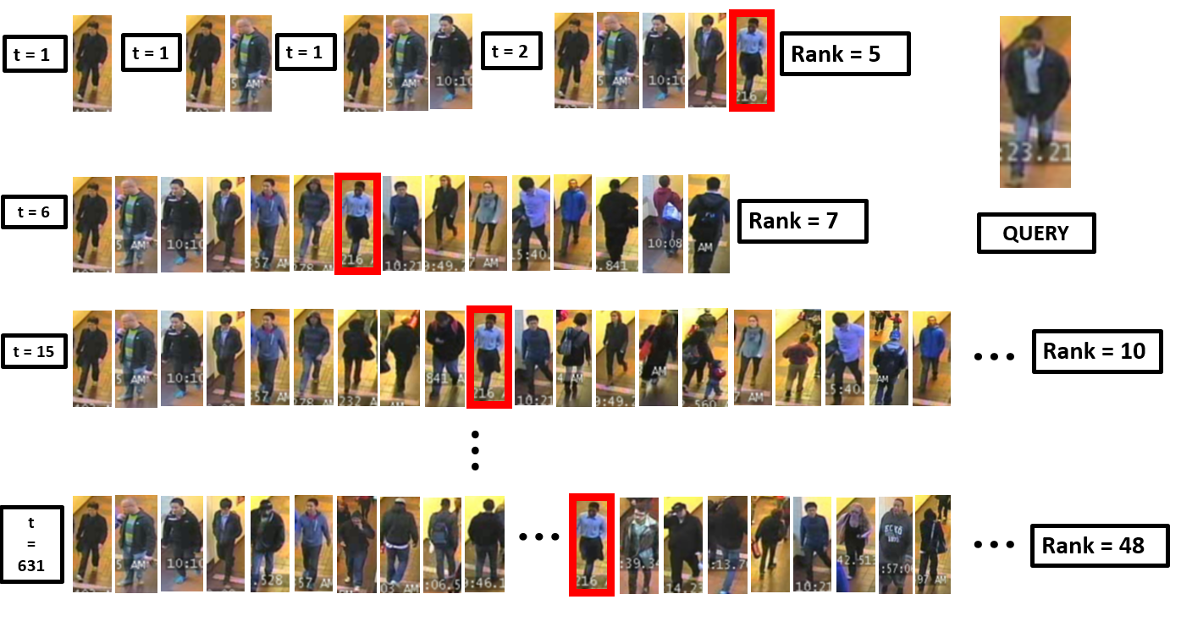
Performance Evaluation
In currently prevalent evaluation, problem over-simplified: temporal aspect ignored
Temporally incremental gallery: how long will correct match stay at rank-1?
Algorithms should be judged on this notion of “persistence”
t in minutes

Slide 5
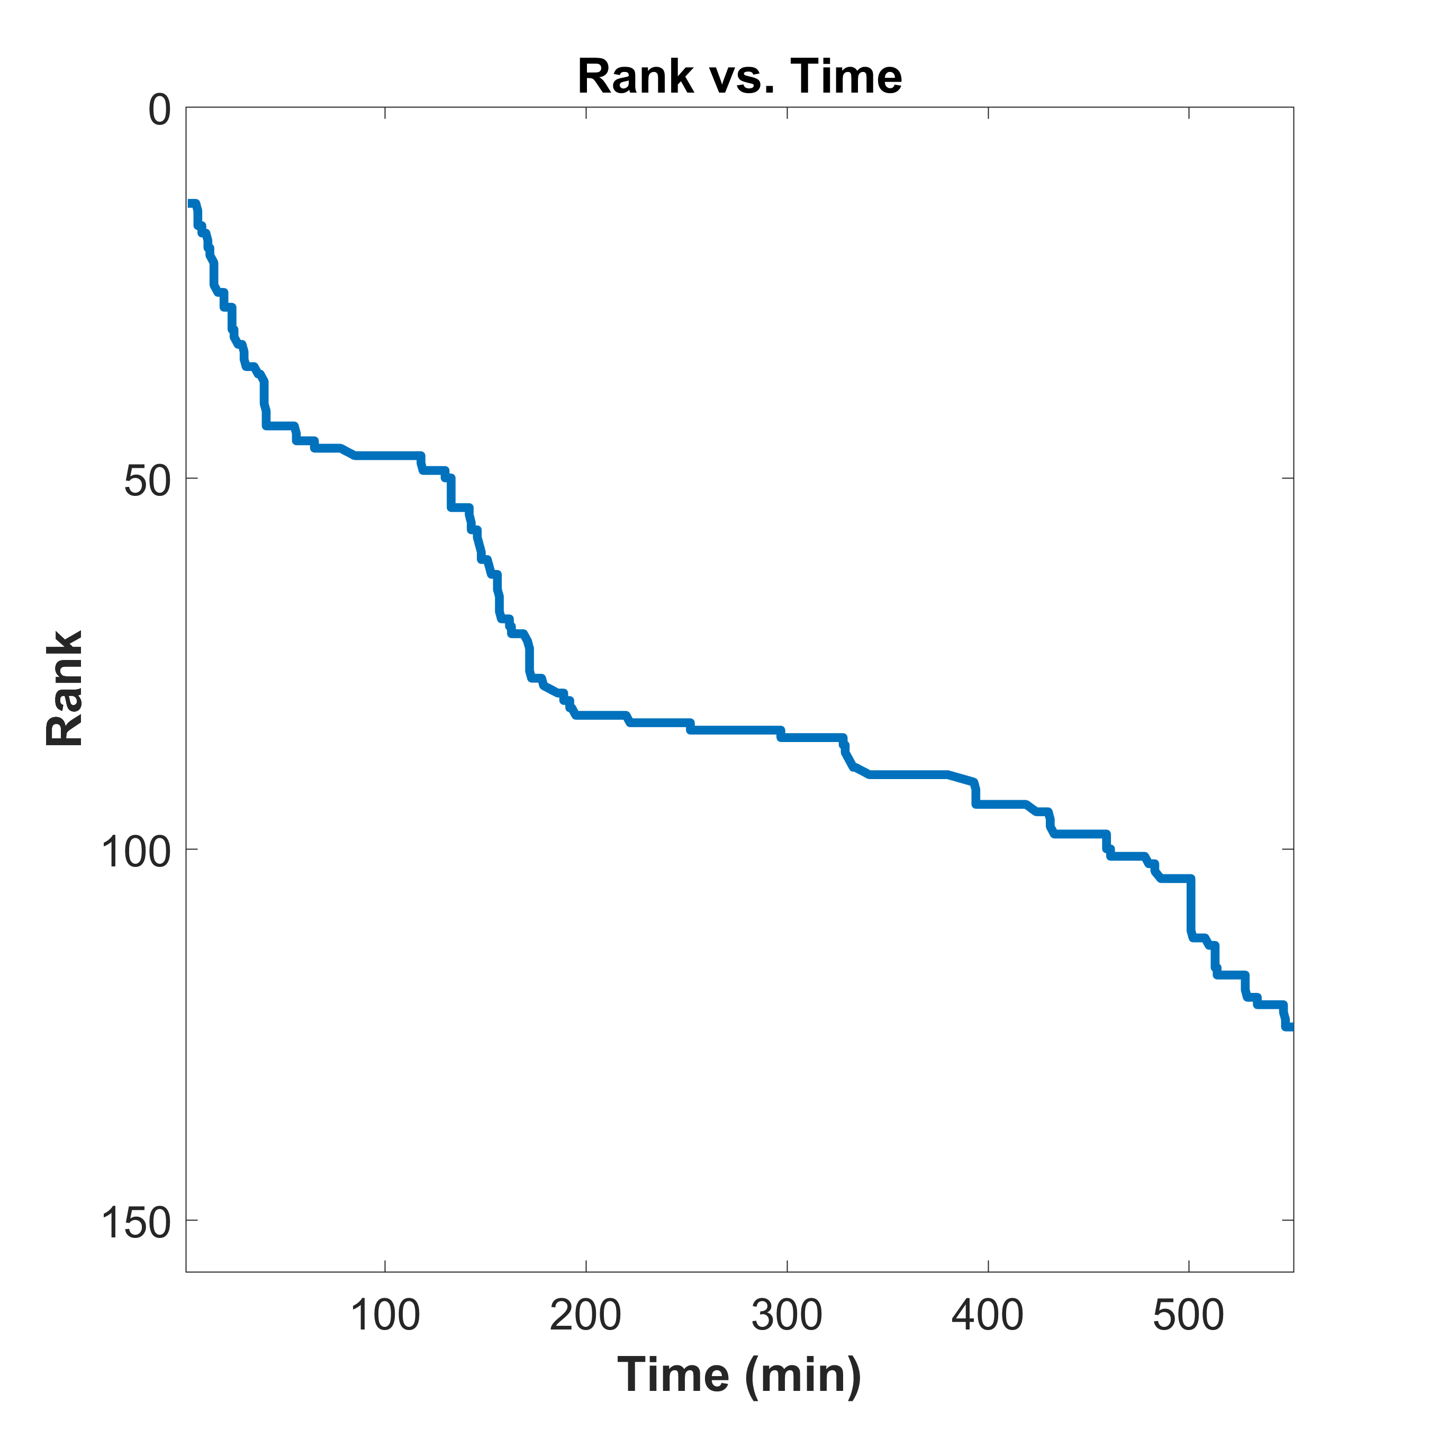
Introducing Rank Persistence
We ask: How long is a correct match to a probe likely to remain in rank-k shortlist?
We distill this information into a rank persistence curve (RPC)
RPCs can be used to directly compare algorithms’ performance

Slide 6
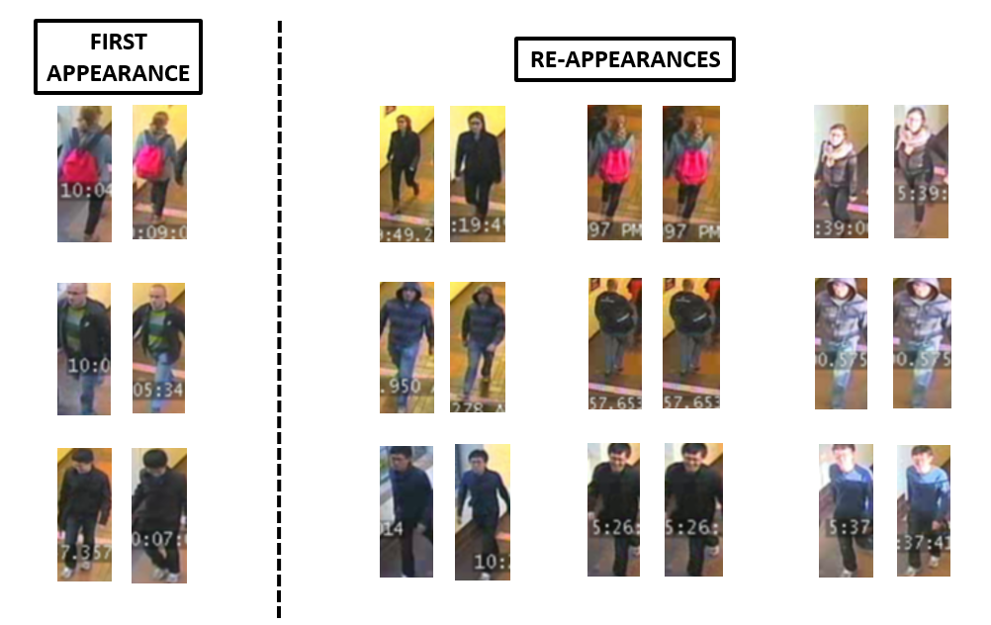
Dataset and Algorithm
Property | Total/Type
# Bounding boxes | 4639
# Known actors | 7
# Known re-apps | 3
# Candidates | 535

Slide 7
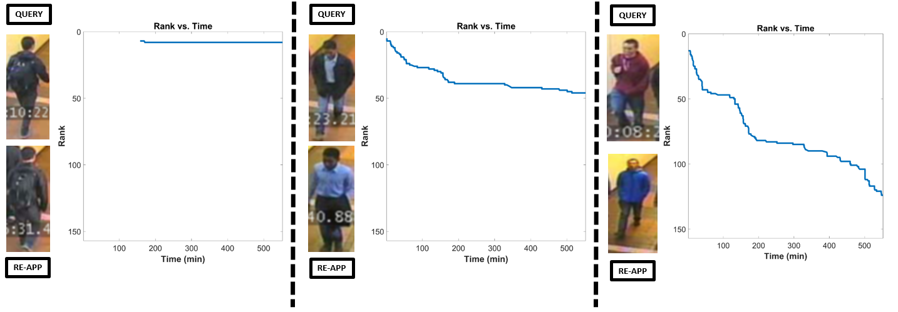
Rank Persistence: One Probe, One Re-appearance
Single query person of interest, single re-appearance in video
Graph how query’s rank varies over time as more people are added to gallery

Slide 8
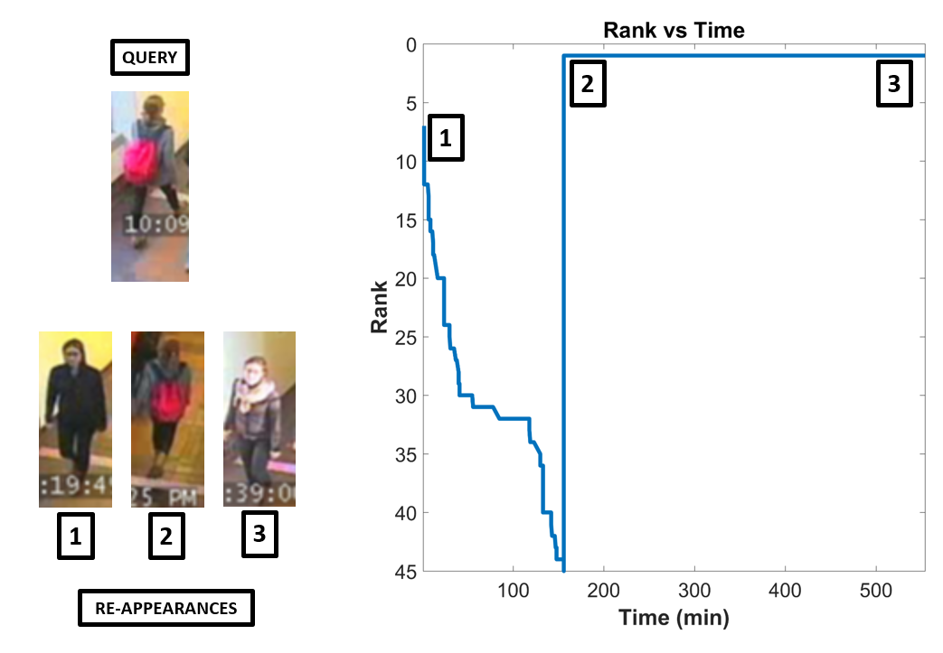
Rank Persistence: One Probe, Multiple Re-appearances
Single query person of interest, multiple re-appearances in video
Graph how query’s rank varies over time as more people are added to gallery

Slide 9
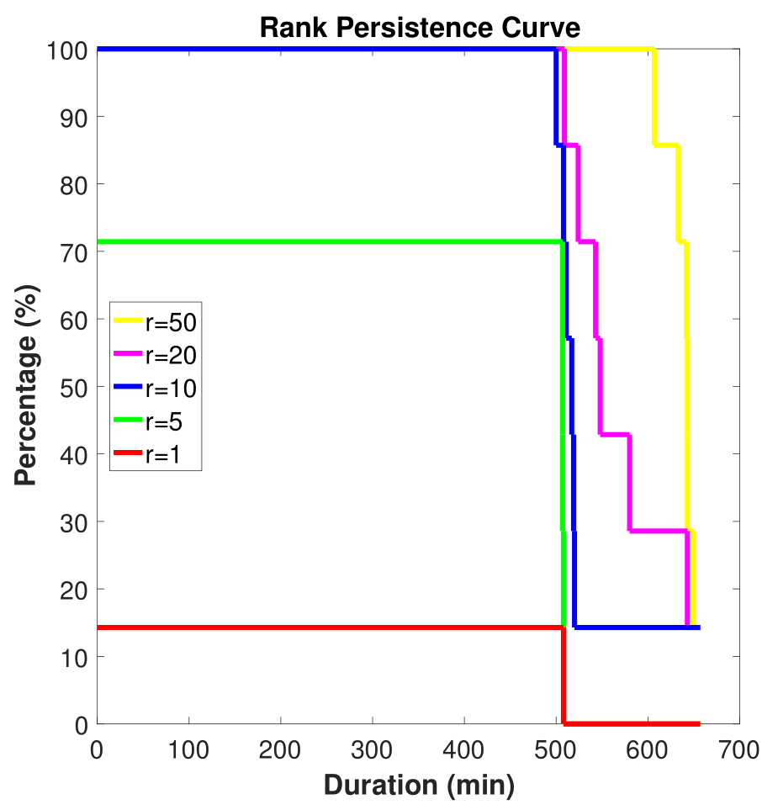
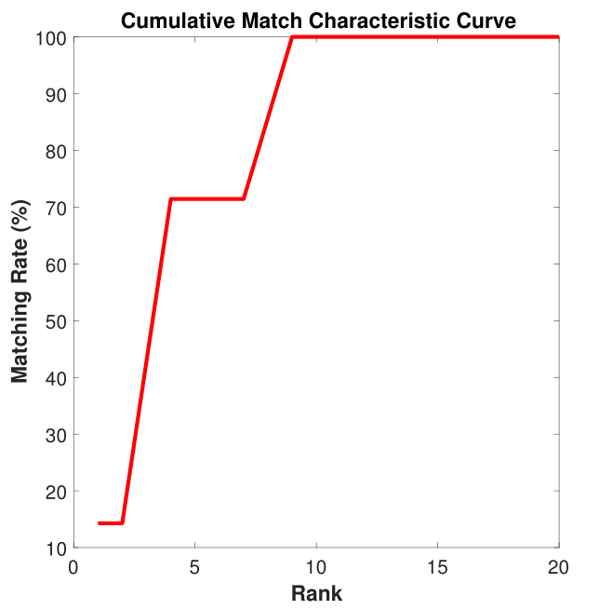
The Rank Persistence Curve: Multiple Probes, Multiple Re-appearances
Characterizes performance of a re-id algorithm for a dataset with multiple probes, each with multiple re-appearances
For each rank r, plot %(probes) that appear in top-r list for at least d units (in mins on x-axis in the left fig)

Slide 10
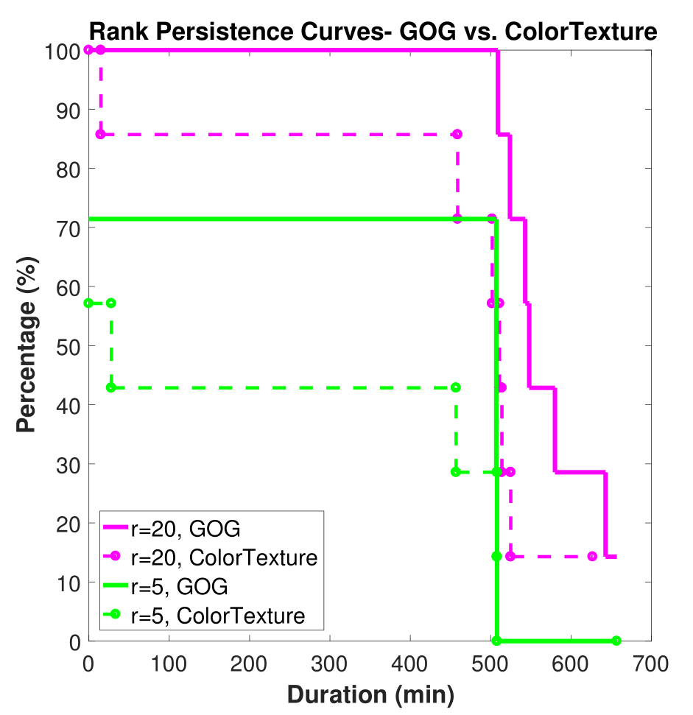
Using RPC to Compare Algorithms
Can be used to directly compare algorithms’ temporal performance
Fix a certain rank, and plot curves
Can help users make informed choices before algorithm deployment in the real world

Slide 11
Discussion and future experiments
A new evaluation metric for real-world re-id: The Rank Persistence Curve (RPC)
Problem: not enough re-id actors/appearances
Existing datasets (MARS, iLIDS-VID, etc) can be repurposed but suboptimal
New outdoor experiment with 12 cameras, many re-id actors, and annotated re-appearances (planned for later this month)
Will integrate with our systematic evaluation and benchmark for re-id:
https://arxiv.org/abs/1605.09653
S. Karanam, M. Gou et al., A Systematic Evaluation and Benchmark for Person Re-Identification: Features, Metrics, and Datasets

Slide 12
Thanks to many people…
Cleveland and GCRTA
Michael Young, John Joyce, Hans Weekley, Ed Hertelendy, Don Kemer, Jim Spriggs
Northeastern
Mengran Gou, Octavia Camps
ALERT
John Beaty, Rick Moore, Deanna Beirne, Alyssa White
All actors in our dataset
Austin Li (RPI), Mengran Gou, Ming Shao (Northeastern), Khalid Tahboub, Blanca Delgado, Javier Ribera (Purdue)
This material is based upon work supported by the U.S. Department of Homeland Security under Award Number 2013- ST-061-ED0001. The views and conclusions contained in this document are those of the authors and should not be interpreted as necessarily representing the official policies, either expressed or implied, of the U.S. Department of Homeland Security.

